Slide 1

WEEK 3 AI PROPOSAL SUITE · GROUP 54
AI Social Media Scheduler
& Content Planner
Platform-Optimized Campaign Automation for Online Tutoring Platforms
Ali Ammar Haider
SafeX Solutions Summer Internship — Group 54

Slide 2


Problem Statement & Business Opportunity
Why LearnHub Academy needs an automated content engine
The Problem
The Opportunity
Creating social campaigns manually takes hours every week.
Copy-pasting one caption everywhere fails platform limits — e.g. X (Twitter)'s 280-character cap.
Inconsistent daily scheduling leads to poor audience engagement.
Automate the full 7-day content creation lifecycle for LearnHub Academy.
Pair platform-specific copywriting with matching AI image-generation prompts.
Ship a developer-ready architecture built for direct social API scheduling.
AI Social Media Scheduler & Caption Generator
2

Slide 3
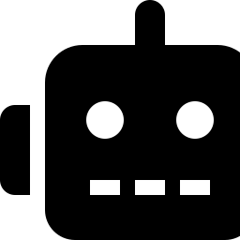

Engine Architecture & Workflows
How engine.py turns a brief into a full weekly calendar
Content Generator Module (engine.py)
Automated Character Audit
Simulated AI caption writer using templates mapped to four tones — Professional, Friendly, Motivational, Promotional.
Rotates daily topics (Python, AI Tools, Excel, Career Tips, Data Analytics, Scholarships, Interview Prep) across every target channel.
Matching image-generation prompts and optimal posting times are produced alongside each caption.
Every caption + hashtag string is measured against each platform ceiling in real time.
X (Twitter) 280 · Instagram 2,200 · LinkedIn 3,000 · Facebook 5,000 characters.
Flags potential truncation before a post is ever queued.
AI Social Media Scheduler & Caption Generator
3

Slide 4


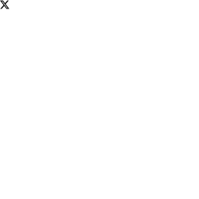

Platform Formatting & Scheduling Rules
Every caption is shaped to fit the platform it ships on
LinkedIn
Instagram
X (Twitter)
Facebook
Long-form, value-driven bullet points with professional hashtags.
Emoji-forward copy, line breaks, and "save this post" triggers.
Short hooks with a clear CTA, strictly under 280 characters.
Community focus with discussion-starter prompts in the comments.
Optimal: 09:00 AM
Optimal: 06:00 PM
Optimal: 01:00 PM
Optimal: 02:00 PM
AI Social Media Scheduler & Caption Generator
4

Slide 5


Interactive Interface & Playgrounds
ui.py turns the engine into a hands-on Streamlit workspace
Streamlit Web Portal (ui.py)
API Proposal Playground
Real-time Campaign Health Dashboard — total posts, platform count, and limit-violation alerts.
Day-by-day interactive editor tabs so a marketer can hand-tune any generated caption.
One-click CSV / JSON calendar export for downstream scheduling tools.
Live code samples for LinkedIn sharing, Tweepy (X), and the Meta Graph API (Instagram).
A Mermaid pipeline diagram maps the async Celery / Cron publishing architecture.
A sample JSON payload shows exactly what the scheduler agent would push to a queue.
AI Social Media Scheduler & Caption Generator
5

Slide 6



Verification & Testing
tests/test_social_media_scheduler.py keeps the engine honest
Unit Test Suite
100%
12
Confirms X (Twitter) captions never exceed the 280-character limit, even at worst-case topic length.
Covers all four tone variations across every supported platform.
Validates full 7-day calendar generation, hashtag output, and image-prompt formatting.
Test Pass Rate
Tests — Week 3 Codebase
0 sec
$0
Cloud LLM Latency
Token Cost Per Run
AI Social Media Scheduler & Caption Generator
6

Slide 7
Summary & Future Scope
Key Takeaways
Future Enhancements
A robust, working campaign prototype tailored to online tutoring needs.
A complete case study with daily work logs and full test coverage.
Platform-aware captions, hashtags, and image prompts generated together.
Connect sandbox API tokens for real-time publishing to live platforms.
Build persistent SQLite storage to save edited calendars across sessions.
Layer in a genuine LLM for fully dynamic, non-templated captions.
Ali Ammar Haider · SafeX Solutions Summer Internship — Group 54

